Slide 1

IMPROVING CUSTOMER SATISFACTION AND INFORMING BUSINESS DECISIONS FOR REVENUE OPTIMISATION
LEVERAGING MACHINE LEARNING FOR DATA-DRIVEN AND PERSONALISED VOICE BUNDLE RECOMMENDATIONS
A CASE STUDY OF AIRTEL UGANDA LIMITED
Remmy Bisimbeko
J24M19/011
Department of Computing & Technology
Faculty of Engineering, Design & Technology
Notes:
Good morning, panel.
My name is Bisimbeko Remmy, registration number J24MD19/007, a candidate for the Master of Science in Data Science and Analytics at Uganda Christian University, Department of Computing and Technology.
The study I am presenting today is titled: Leveraging Machine Learning for Data-Driven and Personalised Voice Bundle Recommendations — Improving Customer Satisfaction and Informing Business Decisions for Revenue Optimisation — A Case Study of Airtel Uganda Limited.
This work was conducted under the supervision of Dr. Daphne Nyachaki Bitalo.
I will take you through the study in approximately 12 minutes, covering the problem, methodology, results, recommendations, and contributions. I welcome your questions at the end.
Key points to land verbally:
Speak slowly and clearly on your name and registration number — the panel is writing it down
Make eye contact with each panellist as you introduce yourself — not at the screen
"I will take you through the study in approximately 12 minutes" — saying this upfront signals that you respect their time and are in control of your presentation
Do not read the title off the slide — you know it, say it naturally
The moment you say "I welcome your questions at the end" — smile. It sets a confident, open tone for the entire session
Take one breath after this slide before moving to the next. Do not rush

Slide 2
Background
The telecommunications industry is increasingly adopting AI and Machine Learning to deliver personalised customer experiences,
improving customer satisfaction, retention, and revenue.
In Uganda, Airtel Uganda serves approximately 10.5 million subscribers (≈47% market share) but faces
3–5% monthly customer churn in a highly competitive prepaid market.
Airtel offers 150+ voice bundles, making it difficult for customers to choose the most suitable option through the current
USSD menu, leading to poor customer experience and lost revenue opportunities.
Machine Learning can analyse customer behaviour and transaction patterns to recommend the right voice bundle at
the right time, replacing generic marketing with personalised recommendations.
This study developed and evaluated a machine learning-based voice bundle recommendation framework using
150 million transactions from 1.46 million Airtel Uganda subscribers, addressing the lack of empirical ML recommendation
research in Uganda's telecom sector.
McKinsey & Company, 2022; Sikri et al., 2024
Uganda Securities Exchange, 2025; Publicist East Africa, 2025
Airtel Uganda, 2024
Samuel, 1959; Hastie et al., 2009
Notes:
Good morning panel. Let me start with the context that motivated this study.
The telecom industry globally is shifting toward personalised, AI-driven customer experiences. Airtel Uganda sits right at the centre of that opportunity — 10.5 million subscribers, 47% market share — but faces 3 to 5% monthly churn in one of East Africa's most competitive prepaid markets.
The product side makes it worse. Airtel offers over 150 voice bundle products, but customers navigate them through a USSD menu — essentially a text-based phone menu with no intelligence behind it. A customer who makes long calls at night gets the same generic offer as one who buys small bundles every two days. That mismatch leads to poor experience and, ultimately, lost revenue.
Machine learning solves this by learning each subscriber's behavioural pattern — their call intensity, spending efficiency, device, purchase channel — and recommending the right bundle at the right moment, rather than broadcasting the same campaign to everyone.
This study addressed that gap directly: using 150 million real transactions from 1.46 million Airtel Uganda subscribers, I developed and evaluated a full ML-based recommendation framework — the first of its kind validated on real Ugandan telecom data.
Say "47% market share" and "3–5% monthly churn" with confidence — panel may ask you to contextualise churn
Pause after "USSD menu" — most panellists know what it is but let the image of the limitation land
The phrase "right bundle at the right time" is your thesis in one sentence — say it deliberately
"First of its kind validated on real Ugandan data" — say this clearly, it is your academic contribution

Slide 3
Problem Statement
Airtel Uganda currently uses ARPU-based, rule-based segmentation,
resulting in generic voice bundle promotions rather than personalised recommendations.
Generic campaigns achieve conversion rates below 3%, leading to an estimated 20% marketing budget wastage and
leaving 15% of subscribers inactive or low-spending (McKinsey & Company, 2022).
Irrelevant bundle recommendations reduce customer satisfaction and increase customer churn,
particularly in prepaid markets (Al-Mashraie et al., 2020; Christopher & Nelson, 2024).
With 150+ voice bundles, customers struggle to identify the most suitable option, reducing engagement and revenue potential.
Research Gap: There is no scalable, data-driven ML recommendation system for personalised voice bundle recommendations
in Uganda's telecom sector.
1
Analytical Gap
2
Commercial Gap
3
Experiential Gap
Over-reliance on single-metric (ARPU) segmentation completely ignores individual subscriber consumption rhythms and immediate contextual needs.
Untargeted campaigns yield conversion rates below 3%, leading to 20% marketing budget wastage and a 15% dormant, unmonetized user base.
Irrelevant recommendations from a complex 150+ product portfolio drive customer dissatisfaction and increase churn risk in the prepaid market.
McKinsey & Company, 2022; Sikri et al., 2024
Al-Mashraie et al., 2020; Christopher & Nelson, 2024
Airtel Uganda, 2024
Notes:
Airtel Uganda's current approach to bundle marketing is ARPU banding — subscribers are grouped by how much they spend on average, and everyone in a band gets the same promotion. That is a rule-based system, not a recommendation system. It does not look at how a customer actually behaves.
The numbers tell the story. Conversion rates are below 3% — meaning more than 97 out of every 100 promotional messages generate no purchase. McKinsey estimates that translates to roughly 20% of the marketing budget going to waste. And 15% of subscribers remain inactive or low-spending, not because they do not want bundles, but because they are never offered the right one.
The human consequence is also real. When recommendations are irrelevant, customers disengage. In prepaid markets especially — where there is no contract holding a subscriber — irrelevant offers directly drive churn. Al-Mashraie and colleagues in 2020, and Christopher and Nelson in 2024, both document this pattern.
Add 150 voice bundle options to the mix, and the average subscriber has no practical way to identify what suits them. The USSD menu does not help them choose — it just lists options.
That brings me to the research gap this study addresses: there is currently no scalable, data-driven machine learning recommendation system for personalised voice bundle recommendations in Uganda's telecom sector. That gap is what this work fills.
Say "below 3%" slowly — let it register, it is a damning number
The McKinsey citation grounds the 20% figure — if a panellist challenges it, say "McKinsey's 2022 telecom personalisation report, which I cite in Chapter 2"
"Not because they don't want bundles — because they were never offered the right one" is a strong line, deliver it with conviction
End on the research gap statement — it is your direct bridge to Objective 1

Slide 4
Research Objectives and Questions
MAIN OBJECTIVE
To identify the key customer behavioural attributes that can be used to predict appropriate voice bundles for
individual Airtel Uganda subscribers and to leverage these attributes to develop a machine learning-based
recommendation framework that supports Airtel Uganda's business growth objectives.
SPECIFIC OBJECTIVES
To identify the key customer behavioural attributes and patterns that are most predictive of voice bundle purchase decisions
among Airtel Uganda prepaid subscribers.
RQ1: What are the key customer behavioural attributes and patterns that most effectively predict voice bundle purchase decisions among Airtel Uganda’s prepaid subscribers?
To test and evaluate suitable machine learning models, including appropriate data preprocessing and feature engineering
techniques, for accurately predicting and classifying voice bundle purchase decisions by Airtel Uganda customers.
RQ2: Which machine learning models are most suitable and accurate for predicting and classifying customer voice bundle preferences, and which data preprocessing approaches
best support this task?
To formulate strategic, evidence-based machine learning recommendations for Airtel Uganda to grow its business,
optimise marketing efficiency, and improve customer satisfaction.
RQ3: What strategic recommendations can be derived from the machine learning model's outputs to help Airtel Uganda improve customer satisfaction, reduce churn,
and grow its business?
Notes:
This study is structured around one main objective and three specific objectives, each paired with a research question that the results directly answer.
The main objective is to identify which customer behavioural attributes predict the right voice bundle for a given subscriber — and then use those attributes to build a machine learning recommendation framework that supports Airtel Uganda's commercial goals.
Specific Objective 1 asks: which behaviours actually matter? Not which demographic a subscriber falls into, but how they call, how they spend, what device they use, how frequently they buy. Research Question 1 is the empirical test of that — which attributes most effectively predict purchase decisions.
Specific Objective 2 moves from attributes to models. Once we know what predicts behaviour, which machine learning algorithm classifies it most accurately? And which preprocessing choices — imputation, oversampling, feature engineering — best support that task? Research Question 2 drives the model comparison in Chapter 4.
Specific Objective 3 is the strategic translation. A model that sits in a notebook helps no one. Research Question 3 asks: what should Airtel actually do with these outputs? That is where the three recommendations in Chapter 6 come from.
Notice the structure: identify, build, deploy. Each objective feeds the next, and each research question has a direct answer in the results.
If asked "how do your objectives map to your hypotheses?" — H1 tests RQ1, H2 tests RQ2, H3 tests RQ3. One-to-one mapping, by design
Emphasise Objective 3 — panels sometimes feel applied studies stop at the model. Make clear that strategic deployment is a named objective, not an afterthought
"A model that sits in a notebook helps no one" — say this, it signals commercial awareness

Slide 5
Methodology: Variables
Guided by the 3 Research Questions seen before our research was kept grounded to fully address the objectives set out.
Actual customer, bundle purchase, location and CDRs were obtained from the Airtel Uganda Data warehouse.
A study Population was defined were observed over a 90 Day period - Feb - Apr, 2026 constituting to about 150 million anonymised
transaction records
Only Prepaip customers – approximately 5.4 million were considered hinting on the dorminance of prepaid services, where purchase
decisions are made frequently, independently, and at low denominations, a behavioural pattern distinct from postpaid contractual
environments.
For the geogrpahical scope, only areas of Central Uganda were considered to better represent a healthy customer behavior pattern.
Dependent Variable - the voice bundle type purchased by a customer
This variable serves as the target label in the supervised classification models:
the machine learning algorithms are trained to predict which bundle class a customer is most likely to purchase on a given
occasion, based on their behavioural profile
The choice of a categorical dependent variable (Bundle Type) frames this as a multiclass classification problem,
which is why classification algorithms, rather than regression models, form the core analytical tool of this study
Chulu, 2017; Nafiu et al., 2012).
Notes:
This study was guided throughout by the three research questions — every methodological decision traces back to answering one of them.
The data came directly from Airtel Uganda's production data warehouse. Real customer records, real bundle purchases, real Call Detail Records, and real location data — not synthetic, not publicly available benchmarks. That distinction matters for the validity of the findings.
The study population was defined as subscribers observed over a 90-day window, February to April 2026. That window generated approximately 150 million anonymised transaction records — enough volume to train and evaluate machine learning models with high statistical confidence.
The study focused exclusively on prepaid customers — approximately 5.4 million subscribers. This was a deliberate choice, not a convenience. Prepaid is where the problem lives: purchase decisions are made frequently, independently, and at low denominations. Every bundle purchase is an active, unconstrained choice. That behavioural pattern is fundamentally different from postpaid, where a contract removes most of the decision-making. Prepaid is harder to model and more commercially important.
For geographic scope, the study concentrated on Central Uganda — Kampala, Central 1, and Central 2. This region has the densest subscriber base and the most complete behavioural data, giving a representative and commercially significant sample.
Finally — the dependent variable. The target the models are trained to predict is the voice bundle type a customer purchases. Because bundle type is a category, not a number, this is a multiclass classification problem. That is why all four models evaluated — Logistic Regression, Decision Tree, Random Forest, XGBoost — are classifiers, not regression models. The choice of target variable directly determines the choice of modelling approach.
"Real data, not synthetic" — say this clearly, it is a genuine differentiator from most published studies
If asked why prepaid only: "postpaid customers operate under contracts — their behaviour is structurally different and a separate research question"
If asked why Central Uganda only: "highest data density, most representative commercial activity, and geographic scope is stated as a limitation with national extension as future work"
"The choice of target variable determines the choice of model" — this shows methodological awareness the panel will appreciate

Slide 6
Methodology: Variables
Independent Variables - the customer behavioural and contextual attributes that the machine learning models use as
input features to predict the dependent variable
1. Purchase frequency wether daily, weekly or monthly reflects customer engagement intensity
2. Bundle depletion rate measures the speed at which a customer consumes their purchased bundle
3. Temporal purchase features capture the time-of-day, day-of-week, and day-of-month patterns associated with a customer's purchases
4. Average Revenue Per User (ARPU), calculated over rolling 7-day, 30-day, and 90-day windows, captures the customer's spending level and trajectory
5. Recency score quantifies the number of days elapsed since the customer's most recent bundle purchase
Forming the R component of an adapted RFM (Recency, Frequency, Monetary) framework commonly applied in customer behaviour modelling
6. Customer tenure records the duration of the subscriber's relationship with Airtel Uganda in days, which has been identified as a predictor of behavioural stability and bundle preference consistency
7. Finally, Geographic region — derived from the customer's registered home location or most frequent network site — is included as a categorical feature
Chen et al. (2023)
Mahmoud & Asyhari, 2024; Zhao et al., 2023.
Mohaimin et al., 2025
Mahmoud & Asyhari, 2024
Notes:
The independent variables are the input signals the machine learning models use to predict which bundle a customer will purchase. Let me walk through each one and explain why it was included.
Purchase frequency — whether a customer buys daily, weekly, or monthly — captures engagement intensity. A customer who buys every two days has a very different profile from one who buys once a month. That rhythm is predictive.
Bundle depletion rate measures how fast a customer burns through what they bought. A subscriber who depletes a bundle in 6 hours behaves differently from one who makes it last three days. Depletion rate captures usage intensity in a way that raw minutes cannot.
Temporal purchase features — time of day, day of week, day of month — capture when customers buy. Night-time buyers, weekend buyers, and end-of-month buyers have distinct patterns tied to income cycles and usage habits. This was confirmed in Chapter 4 — hourly purchase distribution showed a clear behavioural signal.
ARPU calculated over rolling 7, 30, and 90-day windows captures both the level of spending and its trajectory. A customer whose 7-day ARPU is rising relative to their 90-day average is exhibiting a different intent signal than one whose spend is flat or declining.
Recency score — days since last purchase — is the R in an adapted RFM framework. Recency, Frequency, and Monetary value together form one of the most established approaches to customer behaviour modelling. This study adapts that framework to the prepaid bundle context.
Customer tenure records how long a subscriber has been with Airtel. Longer tenure tends to correlate with more stable, predictable purchasing patterns — and the data confirmed tenure as a significant discriminator across segments.
Finally, geographic region — derived from registered location or most frequent network site — is included as a categorical feature. The Chi-Square test confirmed it is significantly associated with bundle segment, with a chi-squared statistic of 41,482.
If asked "why RFM?" — "RFM is a validated, widely published framework in CRM literature; adapting it to prepaid bundle behaviour gives the feature set theoretical grounding beyond ad hoc engineering"
If asked about multicollinearity between ARPU windows — "the rolling windows capture different temporal signals — trajectory, not just level — and tree-based models like Random Forest and XGBoost are robust to multicollinearity by design"
Say "Chapter 4 confirmed" at least once — it shows the variables were not just theoretically motivated but empirically validated

Slide 7
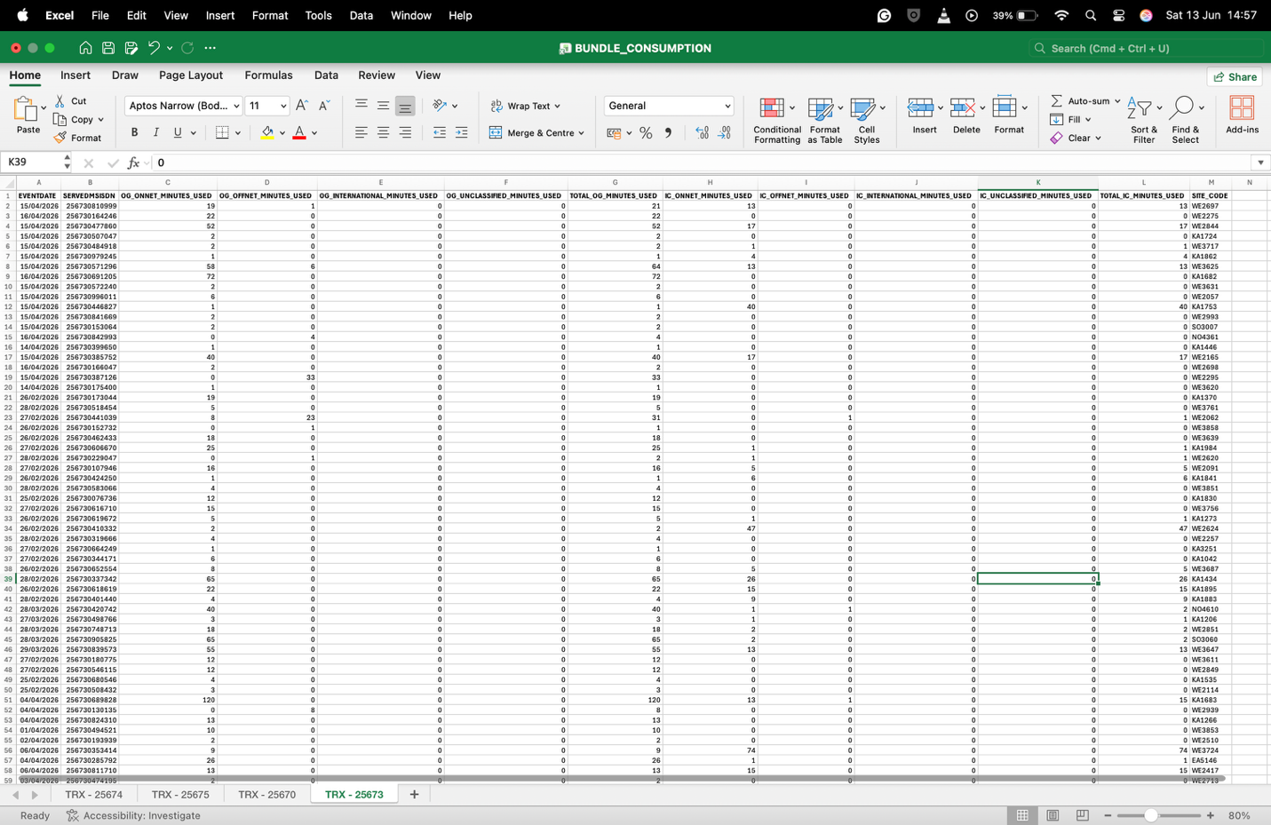
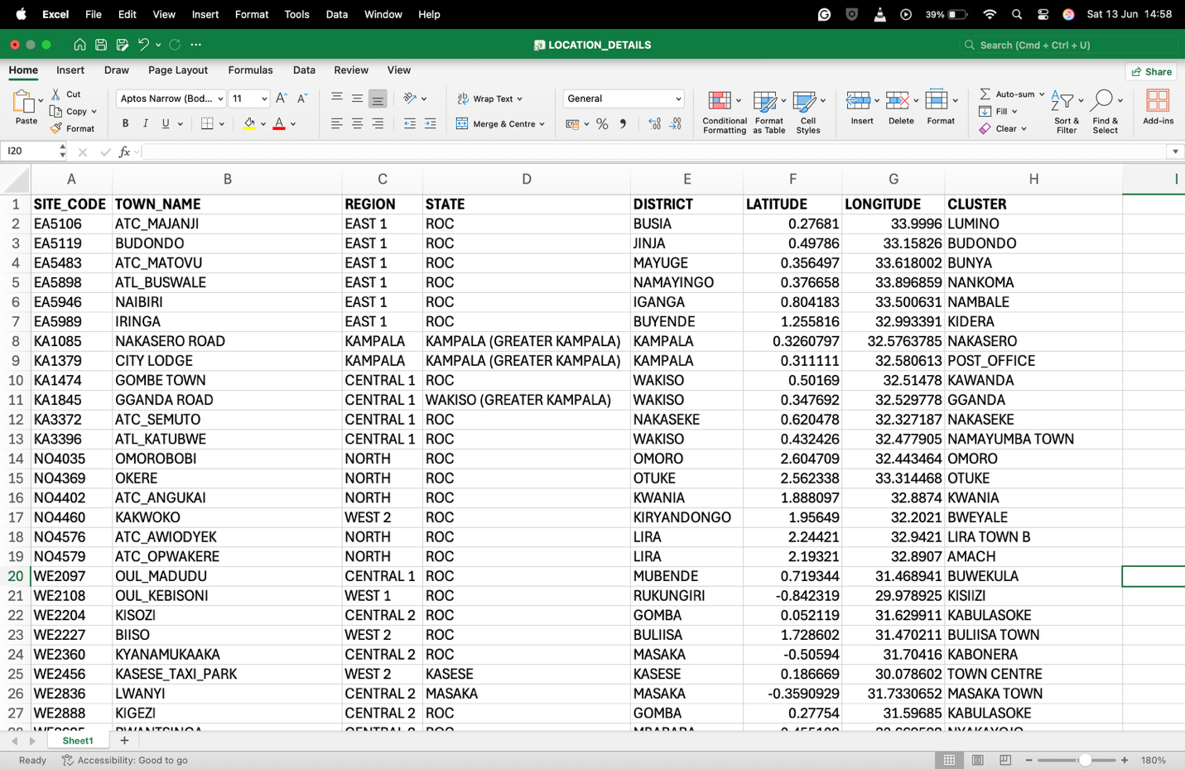
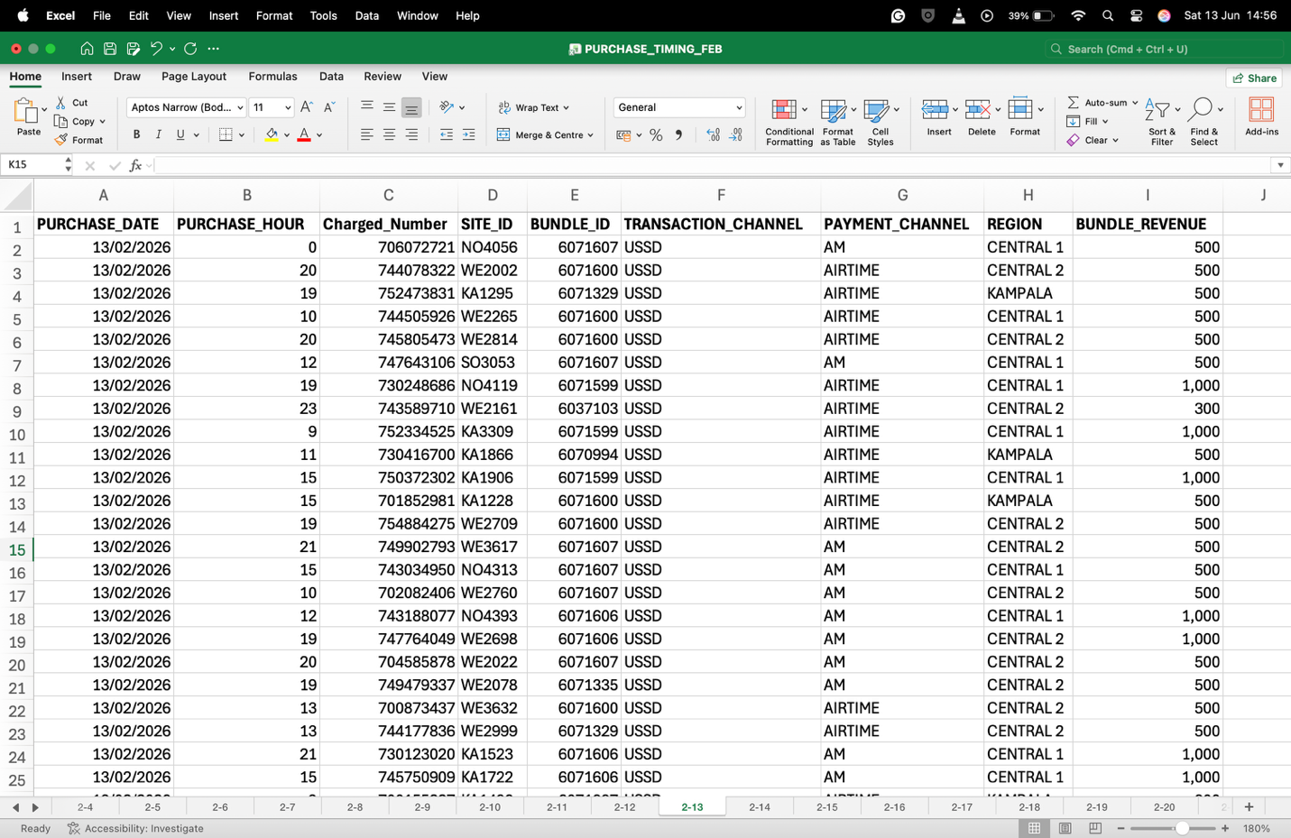
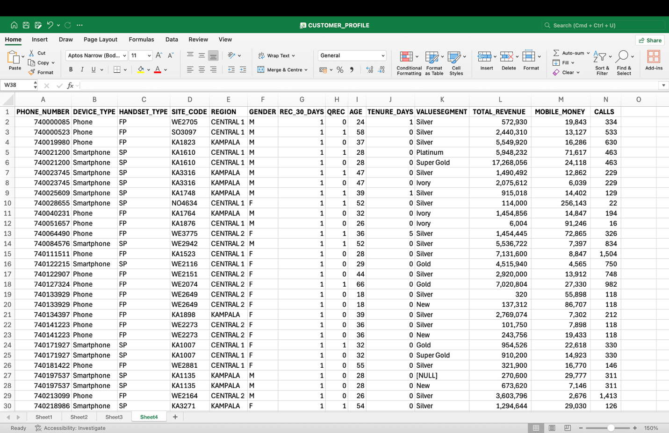
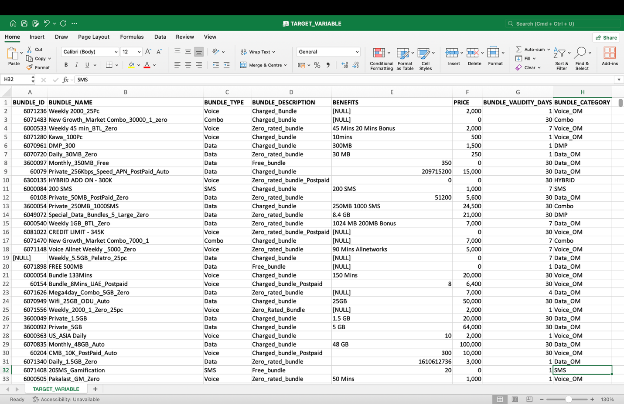
Data Collection
Secondary Data: Historical Transaction Records
The quantitative dataset was extracted from Airtel Uganda Limited's production database by the researcher.
Extracted data was from February and May 2026 using structured Presto/Hive SQL queries executed against four internal data sources.
Dataset | Source Table(s) | Records | Key Variables
TARGET_VARIABLE.csv | leap_product_catalog_master | 1,905 bundles (738 voice) | BUNDLE_ID, BUNDLE_TYPE, BUNDLE_CATEGORY, PRICE, VALIDITY_DAYS
PURCHASE_TIMING (Feb–Apr) | ocsmonmaininternal, ocsloanmaininternal | ~59M rows | PURCHASE_DATE, PURCHASE_HOUR, BUNDLE_ID, TRANSACTION_CHANNEL, BUNDLE_REVENUE
BUNDLE_CONSUMPTION | br_daily_voice_usage | ~500K rows | EVENTDATE, OG/IC MINUTES by type (on-net, off-net, international)
CUSTOMER_PROFILE | subscriberdimension, crystal, subscriber_lifecycle | 1,514,566 rows | PHONE_NUMBER, DEVICE_TYPE, HANDSET_TYPE, AGE, TENURE_DAYS, VALUESEGMENT, TOTAL_REVENUE, CALLS
LOCATION_DETAILS | geo_master | 3,697 sites | SITE_CODE, TOWN_NAME, REGION, LATITUDE, LONGITUDE, CLUSTER
Primary Data: Semi-Structured Interviews
Primary qualitative data was collected through semi-structured interviews with eight key
informants from Airtel Uganda. Semi-structured interviews were chosen because they allow
for sufficient flexibility to explore unexpected themes while maintaining a consistent question
framework across participants, enabling thematic comparison
Notes:
This study used a mixed-methods design — both secondary quantitative data and primary qualitative data. Each strand served a distinct purpose.
The secondary data is the backbone of the quantitative analysis. The dataset was extracted directly from Airtel Uganda's production database by me, as an authorised internal employee, between February and May 2026. The extraction used structured Presto and Hive SQL queries against four internal data sources — the OCS transaction table, the subscriber dimension table, the daily voice usage table, and the geographic master table. This was not a sample drawn from a public dataset. It is real, proprietary, production data, governed by a formal Data Use Agreement that is included in the appendices.
The primary data addressed a question the numbers alone cannot answer — is this framework actually feasible to deploy? Eight key informants from Airtel Uganda's commercial, marketing, data analytics, and technology teams were interviewed using a semi-structured approach. Semi-structured interviews were chosen deliberately. A fully structured questionnaire would have constrained participants to pre-defined answers. Fully unstructured conversations would have made cross-participant comparison difficult. Semi-structured sits in between — a consistent question framework that allows unexpected themes to emerge, which is exactly what qualitative validation of a technical system requires.
Together, the two strands serve the mixed-methods convergent design: the quantitative analysis identifies what the data shows, and the qualitative interviews confirm whether what the data shows is operationally real and deployable in Airtel Uganda's environment.
If asked "why Presto and Hive specifically?" — "Airtel's data warehouse runs on a Hadoop-based architecture; Presto and Hive are the standard query engines for that environment"
If asked about interview ethics — "Participant Information Sheets were provided, consent was obtained, all responses were anonymised — full documentation in Appendix B and D"
If asked "why only 8 informants?" — "qualitative research does not seek statistical representativeness; it seeks informational richness. Eight senior informants covering commercial, technical, and analytics functions reached thematic saturation"
The phrase "operationally real and deployable" — use it, it signals you understand the difference between academic findings and practical implementation

Slide 8
Data Preprocessing and Feature Engineering
All quantitative data preprocessing and analysis were conducted using Python 3.10 within a Google Colab environment
The principal Python libraries employed were:
Pandas for data ingestion, manipulation, and cleaning
NumPy for numerical operations and array handling
Scikit-learn for preprocessing transformations, model training, and evaluation;
Imbalanced-learn for SMOTE(Synthetic Minority Over-sampling Technique) oversampling
XGBoost for the Gradient Boosting classifier implementation.
Statistical Tests
Spearman Rank Correlation – Assessed relationships between numeric features and the target variable.
One-Way ANOVA – Tested whether feature means differed significantly across the 8 customer value segments.
Chi-Square Test – Evaluated associations between categorical features and the target.
Statistical significance was set at α = 0.05.
Data Preprocessing Pipeline
Data Cleaning: Missing value imputation, duplicate removal, and timestamp standardisation.
Feature Engineering: Created behavioural features including ARPU, purchase frequency, recency, bundle depletion rate, and temporal variables.
Encoding: Converted categorical variables into numerical values using Label Encoding.
Class Balancing: Applied SMOTE to the training dataset to address class imbalance and prevent data leakage.
Braun & Clarke, 2006; Turner III, 2010
Field, 2018
Mohaimin et al., 2025
Sikri et al., 2024; Zdziebko et al., 2024).
Notes:
All quantitative analysis was conducted in Python 3.10 on Google Colab — a reproducible, cloud-based environment. The full codebase is publicly available on GitHub so every step can be verified and replicated.
The core libraries were: Pandas for data ingestion and cleaning, NumPy for numerical operations, Scikit-learn for preprocessing and model evaluation, Imbalanced-learn for SMOTE oversampling, and XGBoost for the gradient boosting implementation. Each library was chosen because it is the established standard for its task in Python's data science ecosystem.
Three statistical tests were applied before any modelling, each answering a different structural question about the data. Spearman Rank Correlation measured the strength and direction of relationships between numeric features and the target variable — Spearman rather than Pearson because the behavioural data is non-normally distributed and the target is ordinal. One-Way ANOVA tested whether the mean of each feature differed significantly across the eight customer value segments — a high F-statistic means the feature discriminates between segments. Chi-Square tested whether categorical features are independent of segment membership. All three tests used a significance threshold of alpha equals 0.05.
The preprocessing pipeline had four stages. First, data cleaning — missing values were imputed using the median, duplicates were removed, and timestamps were standardised to enable time-window calculations. Median imputation was chosen over mean because the revenue and usage distributions are heavily right-skewed. Second, feature engineering — ARPU rolling windows, purchase frequency, recency, bundle depletion rate, and temporal variables were constructed from the raw transaction records. Third, encoding — categorical variables were converted to numerical representations using label encoding for compatibility with all four classifiers. Fourth, class balancing — SMOTE was applied to the training set only, never the test set, to prevent data leakage. And critically, SMOTE was capped to avoid inflating the dataset with synthetic records.
"Applied to the training set only, never the test set" — say this explicitly. It shows you understand data leakage, which is a common panel challenge
If asked why median not mean imputation: "revenue and usage metrics are heavily right-skewed — a single high-revenue subscriber would drag the mean upward and misrepresent the typical subscriber"
If asked why label encoding not one-hot: "one-hot encoding on high-cardinality categoricals like region and bundle ID would create hundreds of sparse columns; tree-based models handle label-encoded ordinal-style integers natively"
If asked why Google Colab: "accessible, reproducible, and GPU-enabled for the larger SMOTE and XGBoost operations — and the notebook is on GitHub so the panel can run it themselves"
"Every step can be verified and replicated" — say this with confidence, it is a genuine strength

Slide 9
Model Development and Training
Dataset Split: 70% training, 30% testing using stratified sampling to preserve class distribution.
Models Evaluated:
Logistic Regression (baseline)
Decision Tree (interpretable baseline)
Random Forest (ensemble model with feature importance)
XGBoost (gradient boosting for high-dimensional, imbalanced data)
Hyperparameter Tuning: Performed using GridSearchCV with 5-fold cross-validation.
Model Selection: Best parameters chosen based on the Weighted F1-Score, ensuring robust performance on the imbalanced multi-class dataset.
Model Evaluation
Evaluation Metrics:
Accuracy – Overall proportion of correct predictions.
Precision – Proportion of recommended bundles that were relevant.
Recall – Ability to correctly identify actual bundle purchases.
F1-Score – Balanced measure of Precision and Recall for imbalanced data.
AUC-ROC – Model's ability to distinguish between bundle classes across thresholds.
Best Model Selection: Based on the highest F1-Score and AUC-ROC on the test dataset.
Feature Importance: Used to identify the key drivers of voice bundle recommendations.
Strategic Output: Quantitative results were integrated with qualitative findings to develop
recommendations for Airtel Uganda.
Chang et al., 2024
Sikri et al., 2024; Alotaibi & Haq, 2024).
Alotaibi & Haq (2024)
Shani & Gunawardana (2011)
Notes:
The dataset was split 70% for training and 30% for testing using stratified sampling — stratification ensures every segment class appears in the test set in the same proportion as the full dataset, which matters when one class has 776,000 subscribers and another has 34.
Four models were evaluated in a deliberate sequence. Logistic Regression as the linear baseline — if a straight line cannot separate the classes, we know non-linear models are needed. Decision Tree as an interpretable non-linear baseline. Random Forest as a bagging ensemble — multiple trees voting, with built-in feature importance. And XGBoost as a boosting ensemble — trees built sequentially, each correcting the errors of the last, which is particularly effective on imbalanced, high-dimensional tabular data.
Hyperparameter tuning was done using GridSearchCV with 5-fold cross-validation on the training set. The best parameters were selected based on weighted F1-Score — not accuracy — because accuracy is misleading on imbalanced data. If 53% of subscribers are Silver, a model that predicts Silver for everyone gets 53% accuracy while being completely useless. Weighted F1 accounts for class imbalance.
Five evaluation metrics were computed on the hold-out test set. Accuracy as the overall proportion correct. Precision — of the bundles the model recommended, how many were genuinely the right fit. Recall — of the actual purchases, how many did the model correctly anticipate. F1-Score as the harmonic mean of precision and recall, the primary selection criterion. And AUC-ROC to assess how well the model separates classes across probability thresholds.
Feature importance from the Random Forest model then answered Objective 1 directly — which attributes actually drove the predictions. And the final step integrated those quantitative outputs with the qualitative interview findings to produce the three strategic recommendations for Airtel Uganda.
"Stratified because one class has 776,000 and another has 34" — saying the actual numbers shows you know your data cold
"Accuracy is misleading on imbalanced data" — if you say only one methodological insight in this slide, make it this one. Panels test for it
If asked why GridSearchCV over RandomizedSearchCV: "the parameter space was bounded and computationally feasible with 5-fold CV on the training set; GridSearchCV ensures the optimal combination is found rather than sampled"
If asked about AUC-ROC on a multiclass problem: "we used the One-vs-Rest approach — each class is evaluated against all others, and the scores are averaged using weighted averaging to account for class imbalance"
"Integrated quantitative outputs with qualitative findings" — this is your convergent mixed-methods payoff. Say it deliberately, it shows the two strands were not parallel but actually merged

Slide 10
Results Summary
Objective 1 – Key Customer Behavioural Attributes
Statistical tests applied: Spearman Rank Correlation, One-Way ANOVA, and Chi-Square.
34 of 35 numeric features and all 7 categorical features were significantly associated with voice bundle segments (p < 0.05).
UPGRADE_RATE was the only non-significant feature.
Strongest predictors included:
Total Revenue
Voice Intensity
Bundle Spend (30 Days)
Smartphone Usage
Call Activity
Hypothesis H1 Accepted: Customer behavioural attributes significantly predict voice bundle segment membership.
Objective 2 – Machine Learning Model Performance
XGBoost achieved the highest Accuracy (68.0%), Precision (67.0%), Recall (68.0%), and F1-Score (0.6611).
Outperformed all benchmark models on the 8-class classification task.
Hypothesis H2 Accepted: XGBoost is the best-performing prediction model.
Objective 3 – Feature Importance & Business Impact
Top Predictive Features by Relative Importance – Random Forest Model
Total Revenue – 18.01%
Spend per Minute – 6.57%
Calls – 5.97%
Voice Intensity – 5.87%
Mobile Money Usage – 4.64%
Projected Business Impact
Voice bundle conversion rate: 3% → 12–15%
ARPU increase: +9%
Customer satisfaction: 15–20% improvement
Supports deployment of a personalised ML-based recommendation engine.
Hypothesis H3: Supported by the simulated pilot evaluation.
Model | Accuracy | Precision | Recall | F1-Score
Logistic Regression (Baseline) | 0.5329 | 0.4329 | 0.5329 | 0.4465
Decision Tree | 0.6607 | 0.6504 | 0.6607 | 0.6344
Random Forest | 0.6731 | 0.6627 | 0.6731 | 0.6522
XGBoost ◀ BEST | 0.6800 | 0.6701 | 0.6800 | 0.6611
Rank | Feature | Importance (%) | Category
1 | TOTAL_REVENUE (total subscriber revenue) | 18.01% | Financial
2 | SPEND_PER_MINUTE (revenue per minute used) | 6.57% | Engineered / Efficiency
3 | CALLS (total call count) | 5.97% | Voice Activity
4 | VOICE_INTENSITY (calls per active day) | 5.87% | Engineered / Behavioral
5 | MOBILE_MONEY (mobile money activity) | 4.64% | Financial
Notes:
Let me take you through the results for each objective in turn.
Objective 1 — Key Customer Behavioural Attributes
Three statistical tests were applied to the full dataset of 1,458,900 subscribers. The result was clear: 34 of 35 numeric features and all 7 categorical features were significantly associated with voice bundle segment membership at the alpha equals 0.05 level. The one non-significant feature was UPGRADE_RATE — whether a customer upgrades to a more expensive bundle has no monotonic relationship with their segment. That is itself a finding worth noting.
The strongest predictors were Total Revenue, Voice Intensity, Bundle Spend in the last 30 days, Smartphone usage, and Call Activity. H1 is accepted — customer behavioural attributes significantly predict bundle segment membership.
One important interpretive note: with 1.46 million subscribers, statistical power is extremely high — even very small effects reach significance. So the analytical value is not just that features are significant, but the ranking of their effect sizes. That ranking is what drives the feature engineering and the recommendations.
Objective 2 — Model Performance
XGBoost outperformed all three other models on every weighted metric — 68% accuracy, 67% precision, 68% recall, and an F1-Score of 0.661 on the 8-class hold-out test set of 446,599 records. H2 is accepted.
To put that in context: a random classifier on 8 classes achieves 12.5% accuracy. XGBoost achieves 68% — a 5.4-fold improvement. The F1-Score range across the four models is 0.2146, confirming a meaningful performance hierarchy, not marginal differences.
Objective 3 — Feature Importance and Business Impact
The Random Forest feature importance analysis identified the top five predictors. Total Revenue leads at 18% — expected, since segments are partly revenue-defined. The more important finding is what comes next: Spend per Minute at 6.57%, which is an engineered ratio of revenue to minutes used. That feature does not exist in Airtel's current segmentation system, and it ranks above raw call counts. It tells us spending efficiency is a stronger discriminator than spending volume.
The simulated pilot projected a four to five-fold improvement in conversion rate — from 3% to between 12 and 15% — a 9% uplift in ARPU, and a 15 to 20% improvement in customer satisfaction. H3 is supported by the pilot evaluation, with the A/B test recommended as the confirmatory next step.
"34 of 35" then immediately acknowledge the large-sample caveat — shows intellectual honesty before the panel raises it
"5.4-fold improvement over random" — use this phrase, not just the raw 68%. It contextualises the result properly
On Spend per Minute: "this feature does not exist in Airtel's current segmentation — that is the core commercial contribution" — deliver this clearly and slowly
If asked "why are H1 and H2 accepted but H3 only supported?" — "H1 and H2 are fully confirmed on the hold-out test set. H3 projections are grounded in model precision and external benchmarks, but require a live A/B test for causal confirmation — that is why I say supported rather than accepted"
Say "446,599 hold-out records" when you mention the test set — the panel should know you know that number

Slide 11
Discussion
Key Behavioural Predictors (H1)
Smartphone ownership was the strongest non-revenue predictor of bundle segment.
Recent bundle spending, voice intensity, purchase frequency, and active days were significant indicators of customer value.
UPGRADE_RATE showed no meaningful relationship with bundle segment.
Behavioural features provide better customer segmentation than traditional ARPU-based approaches.
H1 Accepted: Customer behavioural attributes significantly predict voice bundle segment membership.
Model Performance (H2)
XGBoost outperformed Logistic Regression, Decision Tree, and Random Forest (F1 = 0.6611).
XGBoost demonstrated the best predictive performance for personalised voice bundle recommendations.
Performance reflects the complexity of an 8-class imbalanced classification problem, achieving a 5.4× improvement over random prediction.
H2 Accepted: XGBoost is the most suitable model for voice bundle recommendation.
Strategic Insights
Spend per Minute is a stronger predictor than ARPU, highlighting the limitations of current ARPU-based segmentation.
Voice Intensity can serve as a real-time trigger for personalised bundle recommendations.
Mobile Money usage provides an additional signal for customer engagement and targeted marketing.
Projected Business Impact
Recommendation precision: 67%
Conversion rate improvement: 3% → 12–15%
Estimated 9% increase in ARPU
The proposed ML framework has the potential to improve customer targeting, increase conversion rates, and enhance revenue, while reducing irrelevant promotions.
H3: Preliminary support was achieved, but a live A/B test is required to validate the projected business benefits.
Notes:
Now let me interpret what the results actually mean — moving from numbers to insight.
On H1 — Behavioural Predictors
The most important finding here is not the volume of significant features — with 1.46 million subscribers almost everything reaches significance. The insight is the composition of the top predictors. Smartphone ownership was the strongest non-revenue predictor. That is not just a demographic variable — it is a proxy for digital engagement, data literacy, and willingness to interact with higher-tier products. A subscriber on a 4G smartphone has fundamentally different bundle needs from one on a 2G feature phone, even if their ARPU is identical.
Recent bundle spend, voice intensity, purchase frequency, and active days all ranked highly — these are behavioural signals observable in real time from the network. And UPGRADE_RATE showed no meaningful relationship with segment, which tells us that monitoring whether a customer upgrades is not a useful indicator of who they are. What they do every day is far more informative than what they occasionally choose to change.
The headline conclusion: behavioural features provide better segmentation than ARPU bands. ARPU tells you what someone spent. Behaviour tells you what they are likely to do next.
On H2 — Model Performance
XGBoost winning is consistent with the literature — gradient boosting consistently outperforms other algorithms on imbalanced, high-dimensional tabular data. The F1 of 0.661 should be interpreted in context: this is an 8-class problem with a 1-to-22,000 class ratio between Diamond and Silver. Against the honest baseline of 12.5% random accuracy, a 5.4-fold improvement is a strong result.
On Strategic Insights
Three findings stand out for Airtel's commercial team. First — Spend per Minute outranks ARPU as a predictor. Two customers with the same monthly spend but different minutes-per-shilling profiles need completely different bundles. ARPU banding cannot see that distinction. This single insight justifies the move to behavioural recommendation.
Second — Voice Intensity is a real-time trigger. When a subscriber's calls per active day spike above their personal baseline, they are about to run out of bundle. That is the moment to push a recommendation — not on a weekly campaign schedule, but at the moment of intent.
Third — Mobile Money usage adds a dimension beyond voice. Subscribers who actively use mobile money show a distinct engagement profile that correlates with higher-value segments. This creates a cross-service recommendation opportunity Airtel already has the data to act on.
On H3 — the projected impact of 67% recommendation precision, conversion improvement from 3% to 12-15%, and 9% ARPU uplift are grounded in the model's performance and external benchmarks. Preliminary support is the honest assessment. A randomised A/B test is the confirmatory step — and that is precisely what Recommendation 3 specifies.
"ARPU tells you what someone spent. Behaviour tells you what they are likely to do next." — memorise this line and deliver it as your discussion slide's anchor
If asked to elaborate on why XGBoost beats Random Forest specifically: "boosting corrects errors sequentially — each tree targets the mistakes of the previous one. Bagging averages independently-trained trees. On imbalanced data, sequential error correction handles the minority classes more effectively"
"Moment of intent" for the Voice Intensity trigger — use this phrase, it is commercially compelling and technically precise
Pause after "preliminary support is the honest assessment" — let the panel register that you are not overclaiming. That intellectual honesty is a strength, not a weakness

Slide 12
Recommendations
Deploy a Personalised Recommendation Engine | Enrich Customer Segmentation | Establish Testing and Governance Frameworks
Transition from periodic marketing campaigns to a dynamic, event-driven architecture that delivers personalized recommendations via USSD or SMS. | Update the segmentation framework by incorporating real-time behavioral signals, including handset generation (2G, 3G, 4G, or 5G), preferred transaction channel (USSD, App, or agent), and geographic region. | Launch a live, randomized A/B test for a minimum of 90 days to compare the new XGBoost recommendations (treatment) against the standard generic experience (control).
Utilize the XGBoost classification model to trigger recommendations when a subscriber's VOICE_INTENSITY (calls per active day) surpasses their 30-day rolling average by more than 20 percent. | Implement this new segmentation via a phased rollout, initially targeting subscribers in the Kampala, Central 1, and Central 2 regions before expanding nationally. | Track key business metrics during the test, specifically focusing on bundle purchase conversion rates, Average Revenue Per User (ARPU), and bundle repurchase frequency.
Offer higher-tier bundles to users whose SPEND_PER_MINUTE exceeds the median for their specific value segment. |  | Create a formal Model Governance Framework that includes a real-time performance dashboard, quarterly model retraining cycles, and a closed-loop feedback system to log and learn from each recommendation event.
Notes:
Slide: Recommendations
The three recommendations translate the model's outputs into an operational deployment pathway. They are sequenced deliberately — trigger, enrich, govern.
Recommendation 1 — Deploy a Personalised Recommendation Engine
The core insight from the feature importance analysis is that Voice Intensity — calls per active day — is a real-time, network-observable signal. The recommendation is to configure the XGBoost model as an event-driven engine: when a subscriber's Voice Intensity exceeds their own 30-day rolling average by more than 20%, that is the trigger. The model scores their full behavioural profile and delivers a personalised recommendation via USSD push or SMS — at the moment of intent, not on a weekly campaign schedule.
For subscribers whose Spend per Minute exceeds the median for their current segment, the engine surfaces a higher-tier bundle. These are customers whose efficiency profile indicates capacity for a more expensive product, even if their raw ARPU does not.
This replaces a broadcast campaign architecture with a dynamic, event-driven one. Same channels — USSD, SMS — but completely different logic behind them.
Recommendation 2 — Enrich Customer Segmentation
The statistical tests confirmed that handset generation, preferred transaction channel, and geographic region are all significantly associated with bundle segment — yet none of these appear in Airtel's current ARPU bands. The recommendation is to incorporate all three as segmentation variables. Crucially, this requires zero new data collection — all three variables already exist in Airtel's production tables. The enrichment is a configuration change, not an infrastructure investment.
The rollout should be phased: start with Kampala, Central 1, and Central 2 — the scope of this study and the regions with the richest behavioural data — before expanding nationally.
Recommendation 3 — Establish Testing and Governance
Projections from a simulated pilot must be validated by a live experiment. The recommendation is a randomised A/B test running for a minimum of 90 days. The treatment group receives XGBoost-driven personalised recommendations at Voice Intensity trigger points. The control group receives the standard generic experience. Primary metrics: bundle purchase conversion rate, ARPU, and repurchase frequency.
Alongside the test, a formal Model Governance Framework should be established: a real-time performance dashboard tracking weekly F1-Score against the 0.661 baseline, quarterly retraining cycles to keep the model current as the bundle catalogue and subscriber behaviour evolve, and a closed-loop feedback system logging every recommendation event and its outcome. Without governance, a well-performing model drifts into an irrelevant one.
Key points to land verbally:
"At the moment of intent, not on a weekly campaign schedule" — this is the sharpest contrast between current and proposed. Deliver it with emphasis
"Zero new data collection" for Recommendation 2 — say this explicitly. It is the commercial case for why this is immediately actionable
If asked "why 20% threshold for Voice Intensity?" — "it is a starting calibration point designed to filter noise while capturing genuine behavioural spikes; the A/B test will provide empirical grounds for refining it"
If asked "why 90 days for the A/B test?" — "90 days captures monthly purchase cycles, seasonal variation within a quarter, and generates sufficient transaction volume for statistically significant conversion rate comparison"
End this slide strongly: "These three recommendations form a complete deployment pathway — trigger, enrich, govern. Not just findings, but a roadmap Airtel can act on."

Slide 13
Limitations of the Study
Model Constraints: Addressed a complex 8-class prediction problem with severe data imbalance, affecting minority class performance. Most of the subs fall under the Silver customer value segment.
Data Matching: Discrepancies existed between historical purchase timing data and the current product catalogue.
Scope & Validation: Findings are limited to Central Uganda regions and rely on projected—rather than live, commercially observed—outcomes.
Short Observation Window/Seasonality: While a three-month data window effectively captures short-term behavior, it may miss broader seasonal shifts like holidays, school terms, festive seasons or annual economic cycles.
Data Privacy & Replicability: Due to the commercially sensitive and proprietary nature of Airtel Uganda's transactional data, the exact model outputs and feature engineering pipeline cannot be fully disclosed, restricting external replicability.
Absence of Live Validation: Projected business impacts—such as conversion rate improvements and ARPU uplift—are based on simulated pilot tests. These remain estimates until empirically validated through a live, randomized A/B test.
Bias in Success Metrics: The study relies primarily on quantitative commercial metrics (revenue and conversions) to measure success, which may overlook the subjective customer experience that direct customer surveys would capture.
Notes:
Every study has boundaries. Naming them clearly is a mark of rigour, not weakness — and the panel will appreciate that I am raising these before they do.
Model constraints. This is an 8-class classification problem with severe class imbalance — 776,970 Silver subscribers against 34 Diamond. Capped SMOTE addressed the imbalance partially, but minority-class performance is visibly lower: Ivory F1 of 0.33 versus Silver F1 of 0.79. That pattern is expected and acknowledged. In practice, the Diamond class is so rare that a key-account team rather than an algorithm would handle it — but the limitation stands.
Data matching. The purchase timing data and the current product catalogue did not match fully — 267 of 738 bundle IDs aligned. Retired and promotional bundles from the 90-day window are no longer in the current catalogue snapshot. Those transactions were excluded rather than mislabelled, so the model is correct on what it sees, but coverage is not complete. The fix — using a historical catalogue for the join — is specified as future work.
Scope and validation. The study covers Central Uganda only — Kampala, Central 1, and Central 2. Rural and peri-urban subscriber behaviour may differ meaningfully, and national generalisation has not been tested. Separately, the projected business impacts — conversion rate improvement and ARPU uplift — come from a simulated pilot on the hold-out set, not from a live commercial deployment. They are estimates until the A/B test confirms them.
Seasonality. Three months captures weekly and monthly purchase cycles effectively, but it cannot capture annual patterns — December festive spending, school-term income constraints, or agricultural income cycles in rural regions. Quarterly retraining in the governance framework is the operational mitigation.
Data privacy and replicability. Because the data is proprietary and commercially sensitive, the raw dataset cannot be published. The full analytical code is on GitHub, but external researchers cannot replicate the exact outputs without access to Airtel's data warehouse. This is an inherent constraint of industry-partnered research.
Bias in success metrics. The study measures success through commercial outcomes — revenue and conversion rates. These are the right metrics for Airtel's business case, but they do not directly capture subjective customer experience. Future work should incorporate customer satisfaction surveys alongside the A/B test metrics to triangulate the full impact.
Open with "naming these before the panel does" — it frames the slide as intellectual honesty, not defensiveness
If a panellist raises a limitation not on this list: "That is a fair point and a valuable direction I did not cover" — then move on. Do not argue
"Correct on what it sees" for the catalogue mismatch — this is the key phrase. The limitation is coverage, not correctness
"Estimates until the A/B test confirms them" — use this exact phrasing for H3. It is the bridge from limitation to recommendation
If asked why you did not collect customer satisfaction surveys: "semi-structured interviews with eight key informants provided the qualitative triangulation within the study scope; customer-level satisfaction surveys are specified in future work as the next validation layer"

Slide 14
Conclusion
Validated ML Framework: Delivered the first published, data-driven recommendation system for Uganda's prepaid market, analyzing 1.45 million subscriber records.
A Shift in Predictors: Proved that spend efficiency (SPEND_PER_MINUTE) and call frequency (VOICE_INTENSITY) are the most powerful behavioral triggers, challenging the traditional reliance on absolute spend (ARPU).
Massive Performance Gains: The XGBoost model achieved a 0.6611 F1-Score, representing a 5.4-fold improvement over random targeting and a 22-fold improvement over current generic conversion rates.
Notes:
Slide: Conclusion & Contribution
Let me close with what this study actually contributes — three things that did not exist before this work.
First — a validated ML framework for Uganda's prepaid market.
This is the first published, empirically validated machine learning recommendation system built on real transactional data from a Ugandan telecommunications operator. Not a synthetic dataset. Not a public benchmark. 1.45 million real subscriber records, real purchase histories, real Call Detail Records — analysed under a formal Data Use Agreement and fully anonymised. That closes a gap the literature review identified clearly: prior studies in this space all relied on public or synthetic data. This one did not.
Second — a fundamental shift in what we know predicts bundle preference.
The study proves that spending efficiency — Spend per Minute — and call frequency — Voice Intensity — are stronger behavioural triggers than absolute spend. ARPU tells you what a customer spent. It does not tell you whether they are getting value from it, or whether they are about to run out. Spend per Minute and Voice Intensity do. That finding directly challenges the ARPU-banding logic that Airtel — and most telcos in the region — currently rely on. The implication is not incremental improvement of the existing system. It is a different segmentation logic entirely.
Third — a 5.4-fold performance gain, with a clear path to 22-fold commercial improvement.
The XGBoost model achieves an F1-Score of 0.661 — 5.4 times better than random targeting on an 8-class problem. Translate that model precision into commercial terms: current generic campaigns convert below 3%. A system that recommends correctly 67% of the time projects to 12 to 15% conversion — a 22-fold improvement over what is happening today.
Those three contributions together — validated framework, new predictors, deployable performance — represent the answer to why this study needed to be done, and why its findings matter beyond the walls of this room.
Thank you. I welcome the panel's questions.
Key points to land verbally:
Slow down for this slide. You have earned it. Do not rush the close
"1.45 million real subscriber records" — say "real" deliberately. It is the differentiator
"A different segmentation logic entirely" — pause after this. Let it land
"22-fold improvement over what is happening today" — this is your most commercially powerful number. Save it for last and say it with full confidence
End with "I welcome the panel's questions" and make eye contact with each panellist as you say it. Confident, not nervous
If you feel the panel is satisfied after your conclusion — stop talking. The strongest close is a clean one

Slide 15
Directions of Future Research
Live Commercial Validation: Execute a live A/B test to empirically confirm the projected business impacts and return on investment.
Historical Data Integration: Utilize historical product catalogs to resolve matching discrepancies and fully capture complex bundle-switching behaviors.
Deep Reinforcement Learning (DRL): Evolve the framework by deploying DRL agents that dynamically learn and optimize for long-term customer lifetime value.
Geographic Expansion: Broaden the data scope to Northern, Western, and Eastern Uganda to test if the identified trigger signals are nationally generalizable.
Notes:
Slide: Future Work
This study opens four concrete directions for what comes next — each one addressing a specific boundary of the current work.
Live commercial validation. The most immediate next step is the A/B test. The projected impacts — 12 to 15% conversion, 9% ARPU uplift — are grounded in model precision and external benchmarks, but they are projections. A live randomised experiment, treatment versus control, run for a minimum of 90 days in the Kampala and Central regions, converts those projections into causal evidence. Until that test runs, H3 remains preliminary support. After it runs, we have proof.
Historical data integration. The catalogue mismatch — 267 of 738 bundle IDs matching — is a solvable problem. Using a historical product catalogue that covers the full February to April 2026 observation window rather than the current snapshot would resolve it. That unlocks the full purchase history feature set — particularly bundle-switching behaviour and upgrade patterns — which this study could only partially compute. More complete purchase history data would likely improve model performance further.
Deep Reinforcement Learning. The XGBoost model is a static classifier — it learns from historical patterns and predicts. A Deep Reinforcement Learning agent goes further: it learns dynamically from live customer responses, updating its recommendation policy in real time to maximise long-term customer lifetime value rather than a single purchase event. DRL represents the current research frontier for recommendation systems in telecoms and is the natural evolution of this framework once the A/B test establishes the commercial baseline.
Geographic expansion. This study covers Central Uganda. The trigger signals identified — Voice Intensity, Spend per Minute, Smartphone ownership — may behave differently in Northern, Western, and Eastern Uganda, where income patterns, network coverage, and usage habits differ. Expanding the data scope to test national generalisability is essential before Airtel can confidently deploy the framework at scale across all regions.
Key points to land verbally:
"Converts projections into causal evidence" for the A/B test — use this phrasing, it shows you understand the difference between correlation, projection, and causality
If a panellist asks "why didn't you use DRL in this study?" — "DRL requires a live feedback environment to learn from — it cannot be trained on historical batch data alone. The XGBoost framework establishes the performance baseline the DRL agent would need as a starting point"
"H3 remains preliminary support. After it runs, we have proof." — deliver this as two short, punchy sentences with a pause between them
If asked which future direction you would prioritise: "the A/B test — because it validates everything else. Without commercial evidence, the other directions are theoretical. With it, the case for DRL and geographic expansion becomes self-funding"
Keep this slide brief in delivery — future work is important but should not eat into your closing time. Two minutes maximum

Slide 16

Thank you

